Slide 1



Slide 2

Analysis of Indian Health
Care System

Slide 3

Project Details
Analyzing the health statistics and the availability of health care services in India.
Input:
Hospital’s information through out the country.
Patients' details including the cause of illness.
Tools:
Hive 2.0
Pig and
Spark2
Output:
Avg age of Patients | Gender Ratio | Affected Diseases | Most Occupied Hospitals | Most Effected city

Slide 4
Objectives
Which Gender is more prone to different disease?
Average age of patients affected with diseases.
Common diseases which affecting most
Number of hospitals in different cities.
Which Hospital and city recorded the highest number of patients.

Slide 5

Description of dataset
The patient data provides the information about the patient details and the disease caused to them.
The hospital dataset gives the information about hospital details and the place of the hospital
PATIENT.csv
● PATIENT_ID
● PATIENT_NAME
● PATIENT _GENDER
● PATIENT _BIRTHDATE
● PATIENT _PHONE
● HOSPITAL_ID
● DISEASE _ NAME
● CITY
HOSPITAL.csv
● HOSPITAL_ID
● HOSPITAL _ NAME
● CITY
● STATE
● COUNTRY

Slide 6

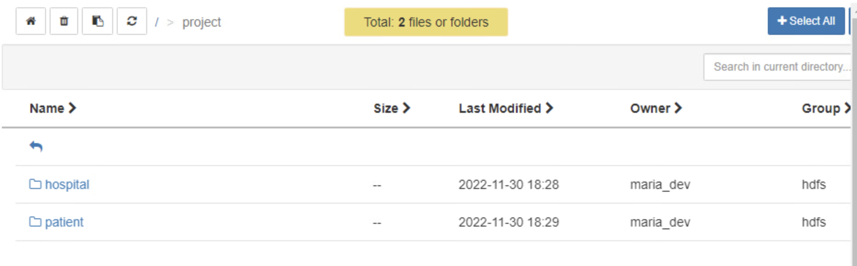
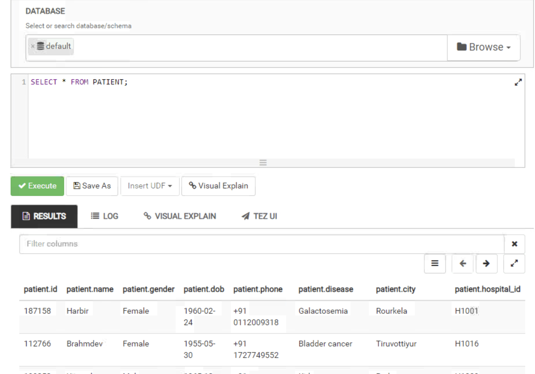
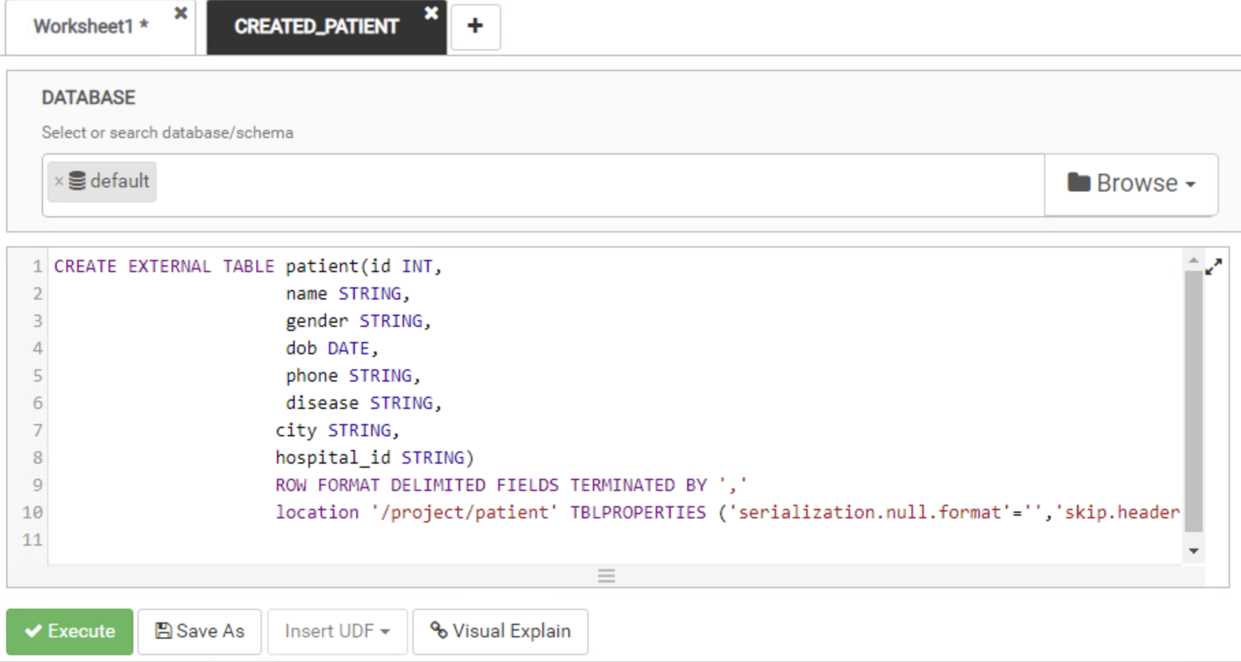
Loading the Dataset for Analysis

Slide 7

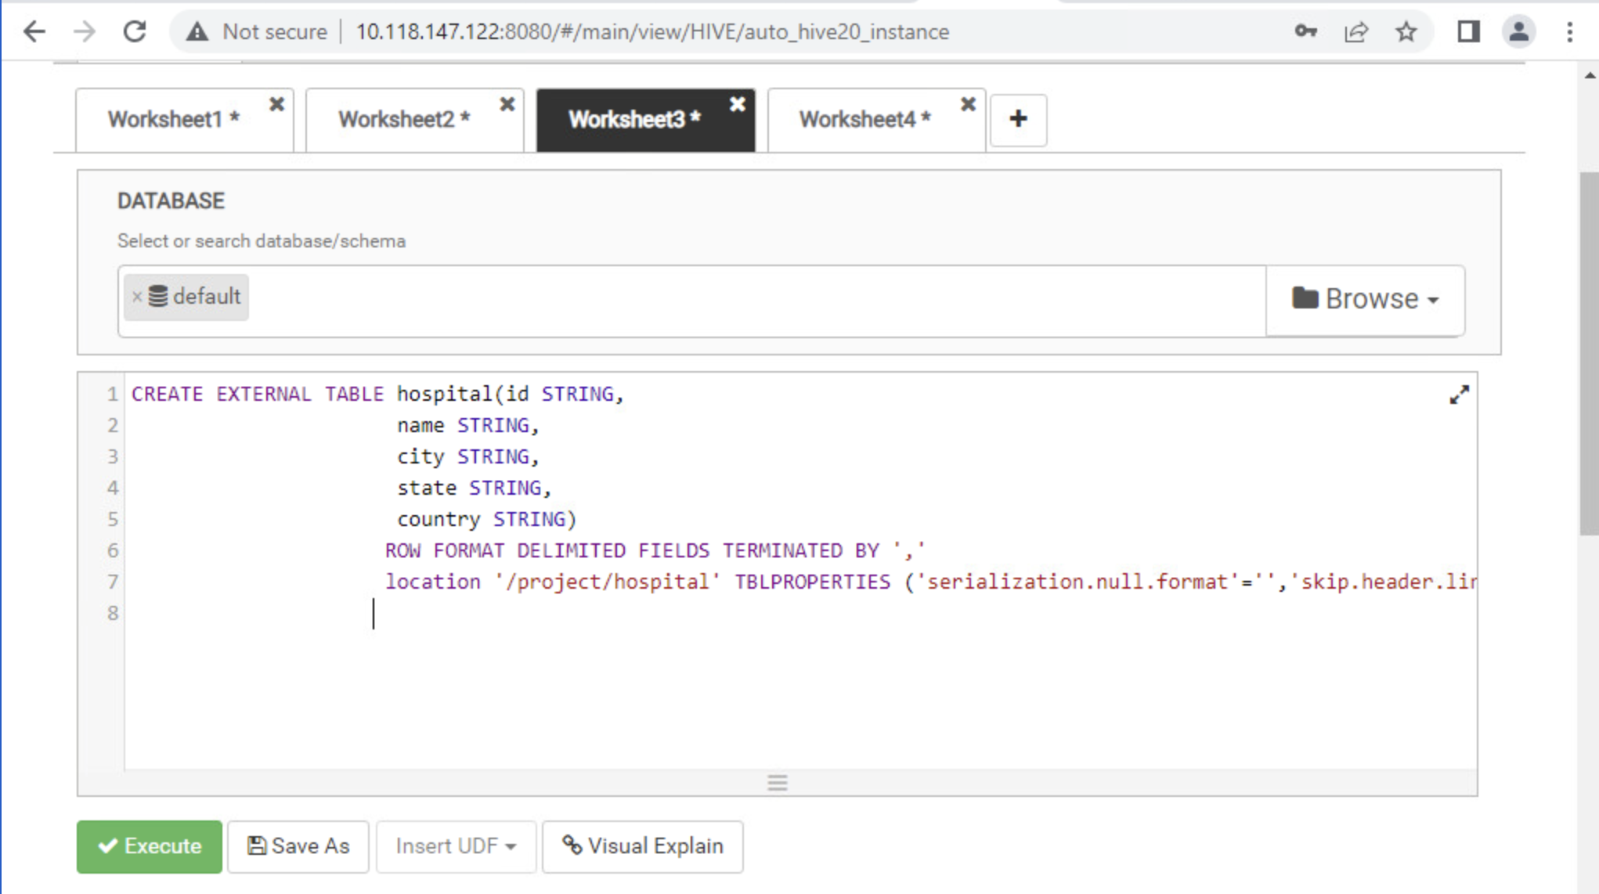
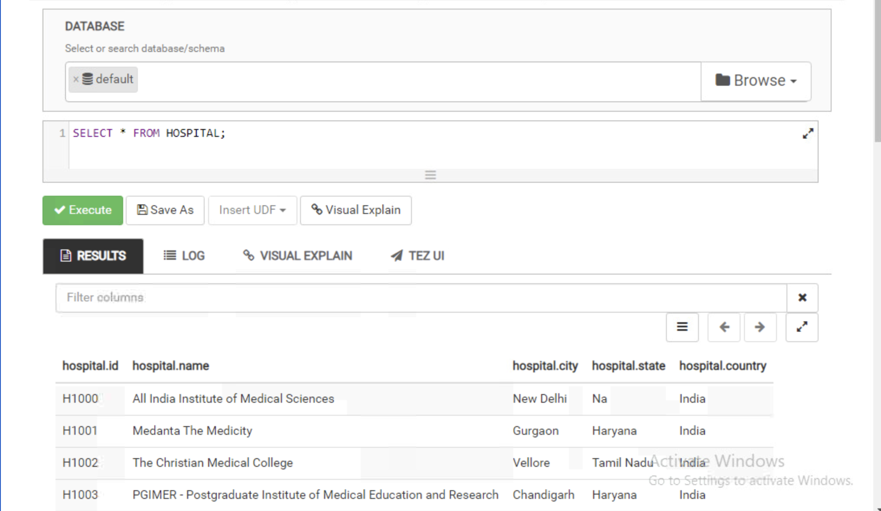
Loading the Dataset for Analysis

Slide 8
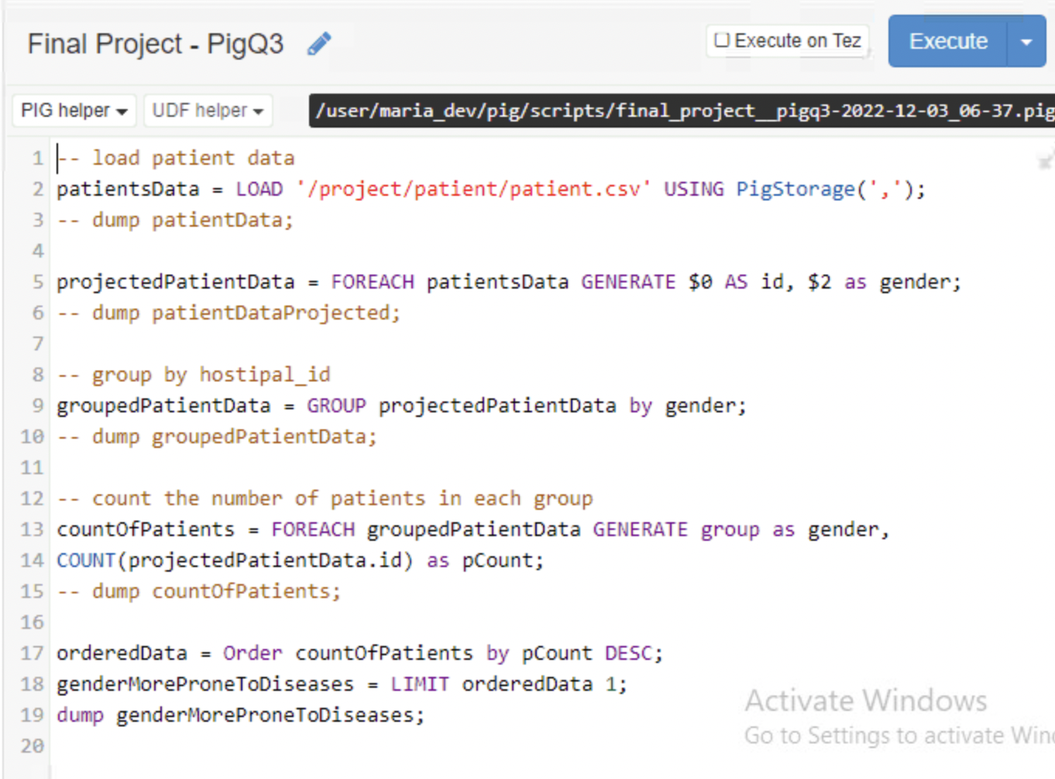
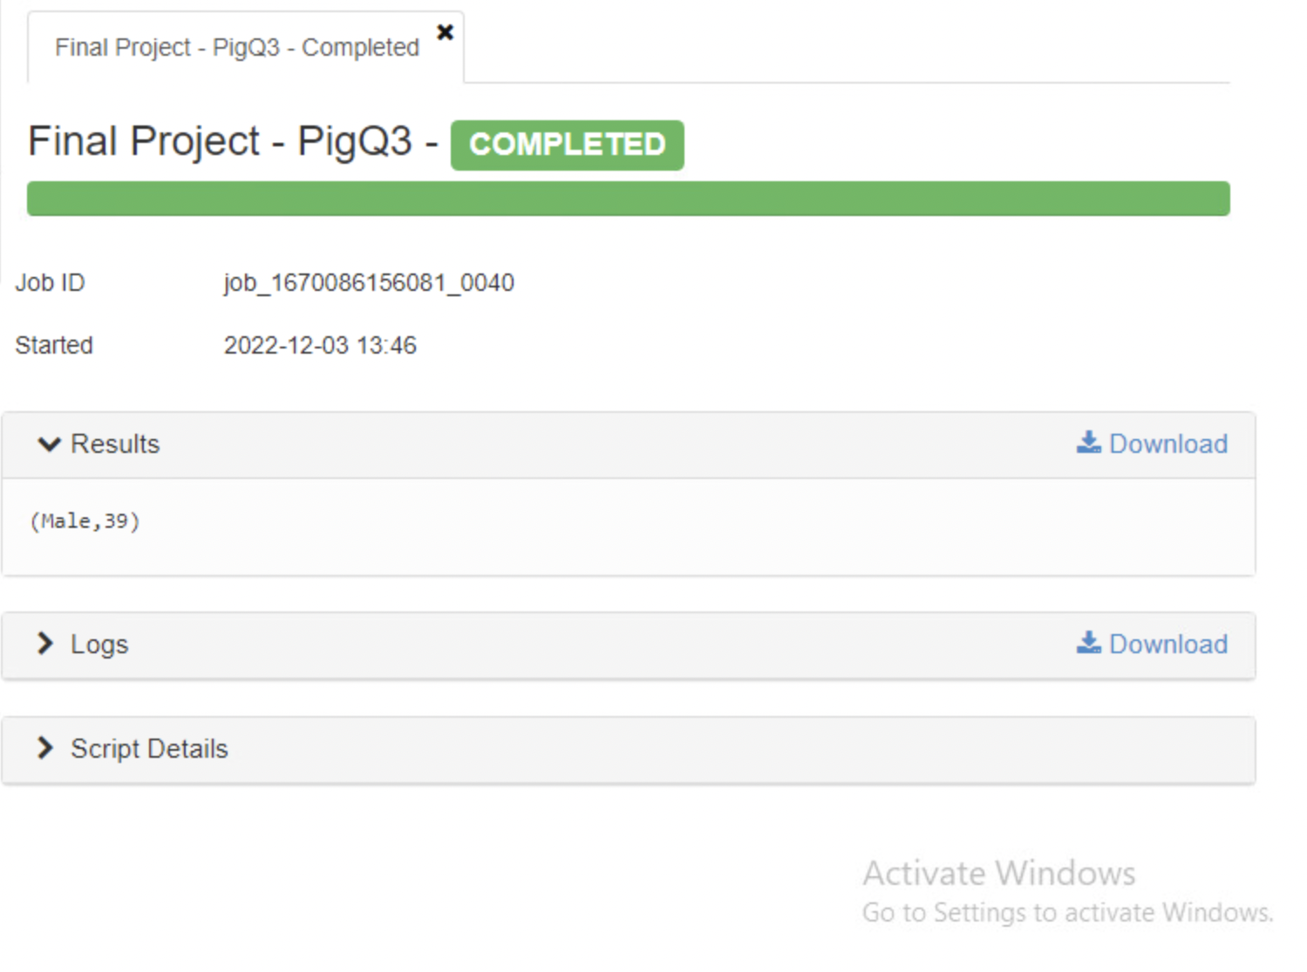
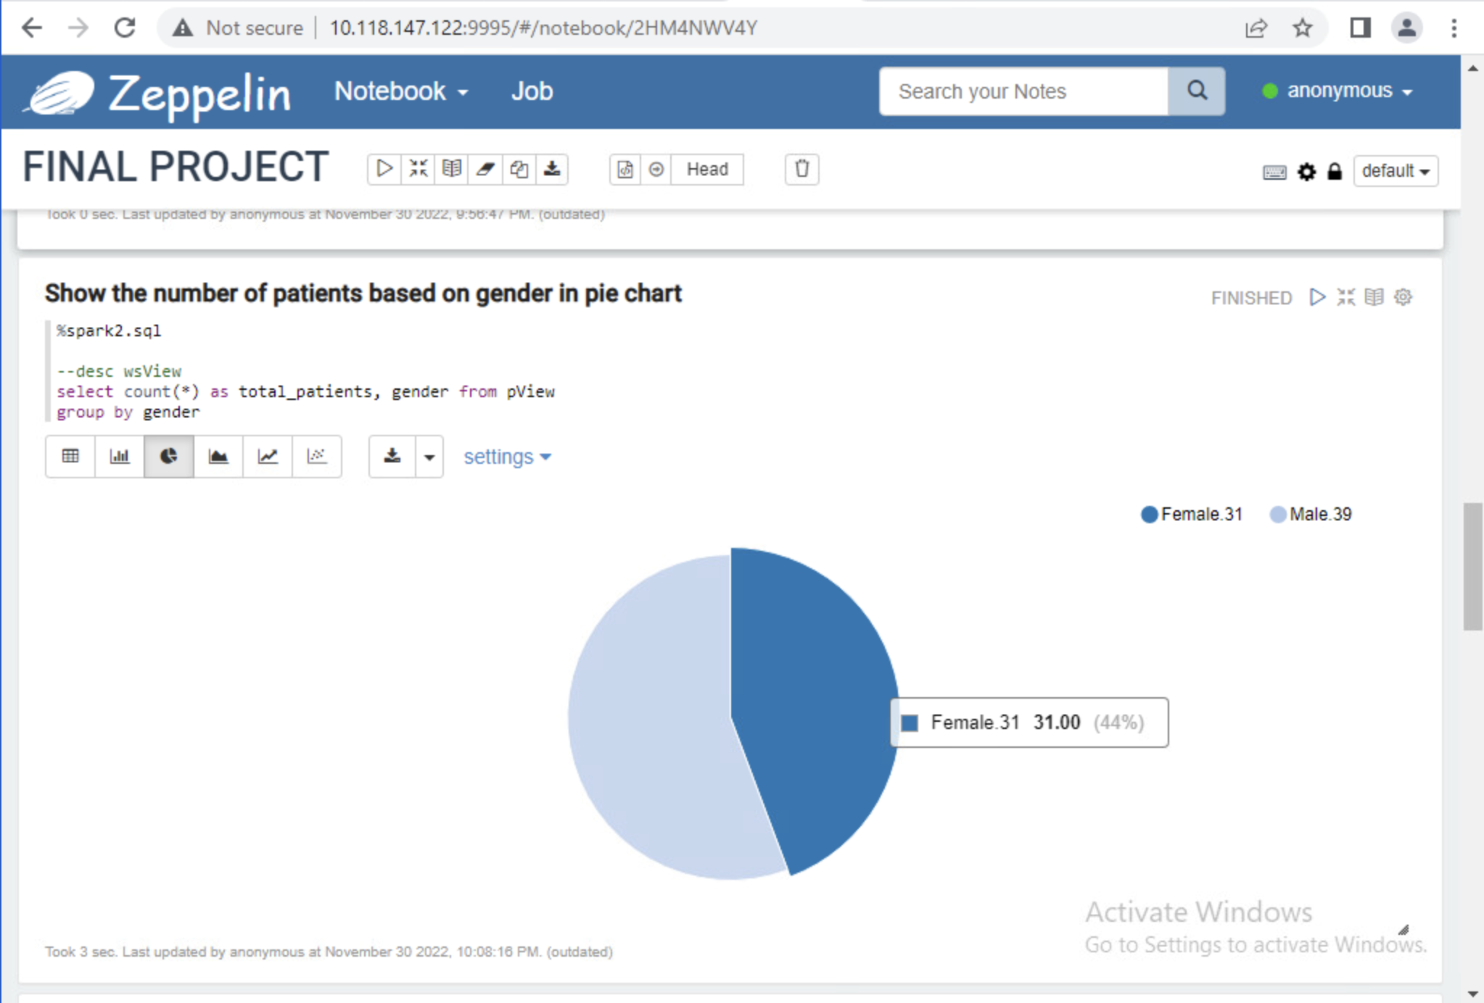
Which Gender is more prone to different diseases?

Slide 9
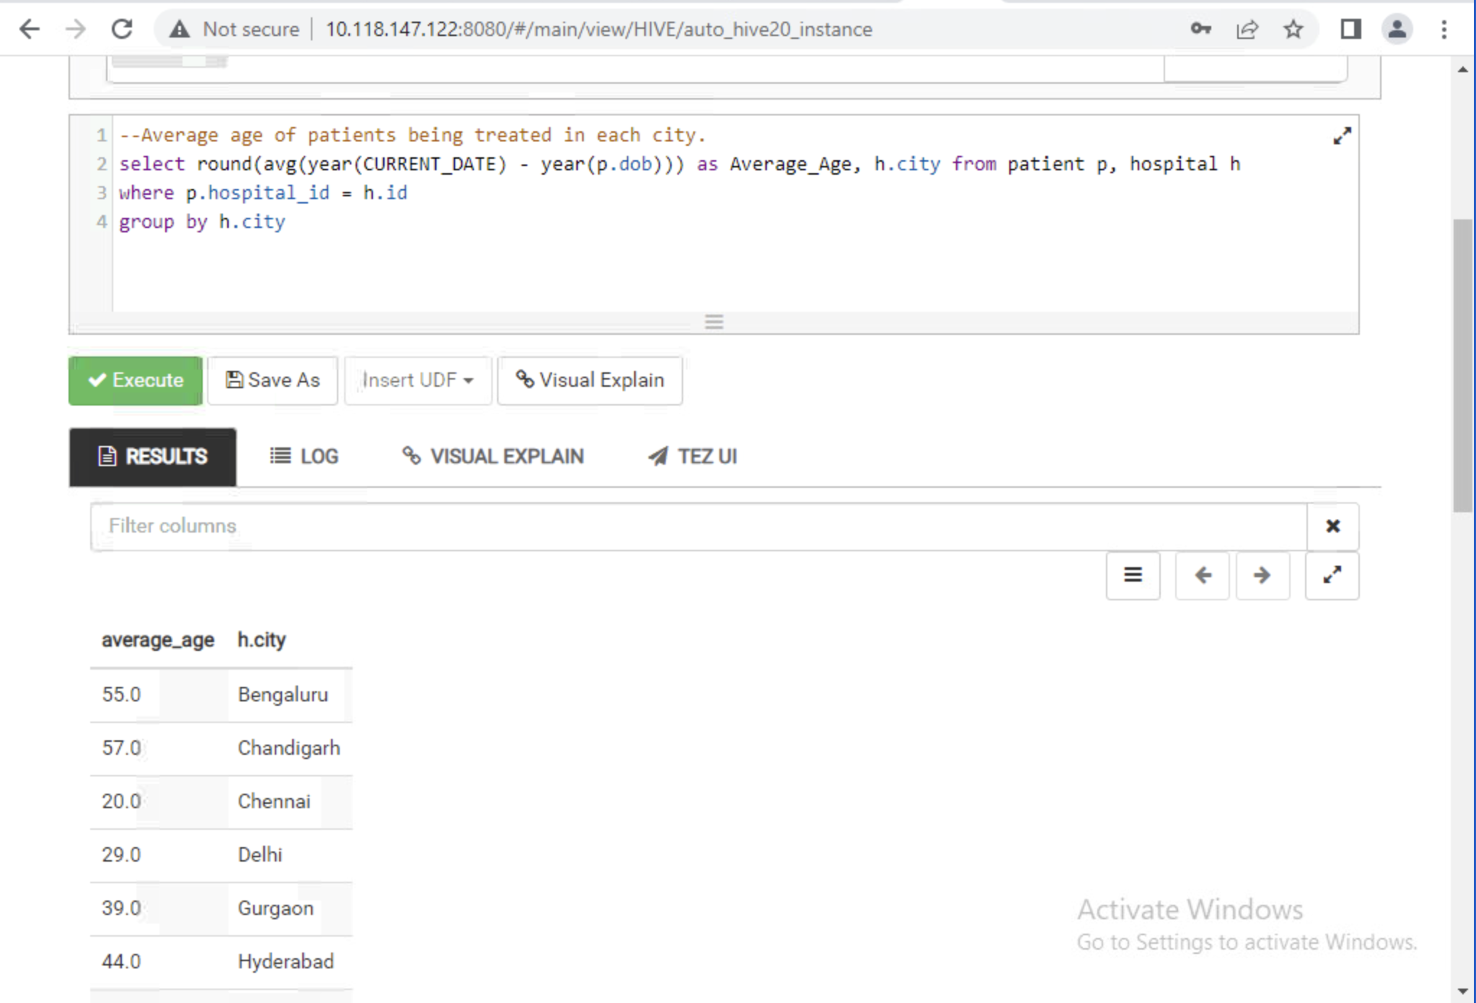
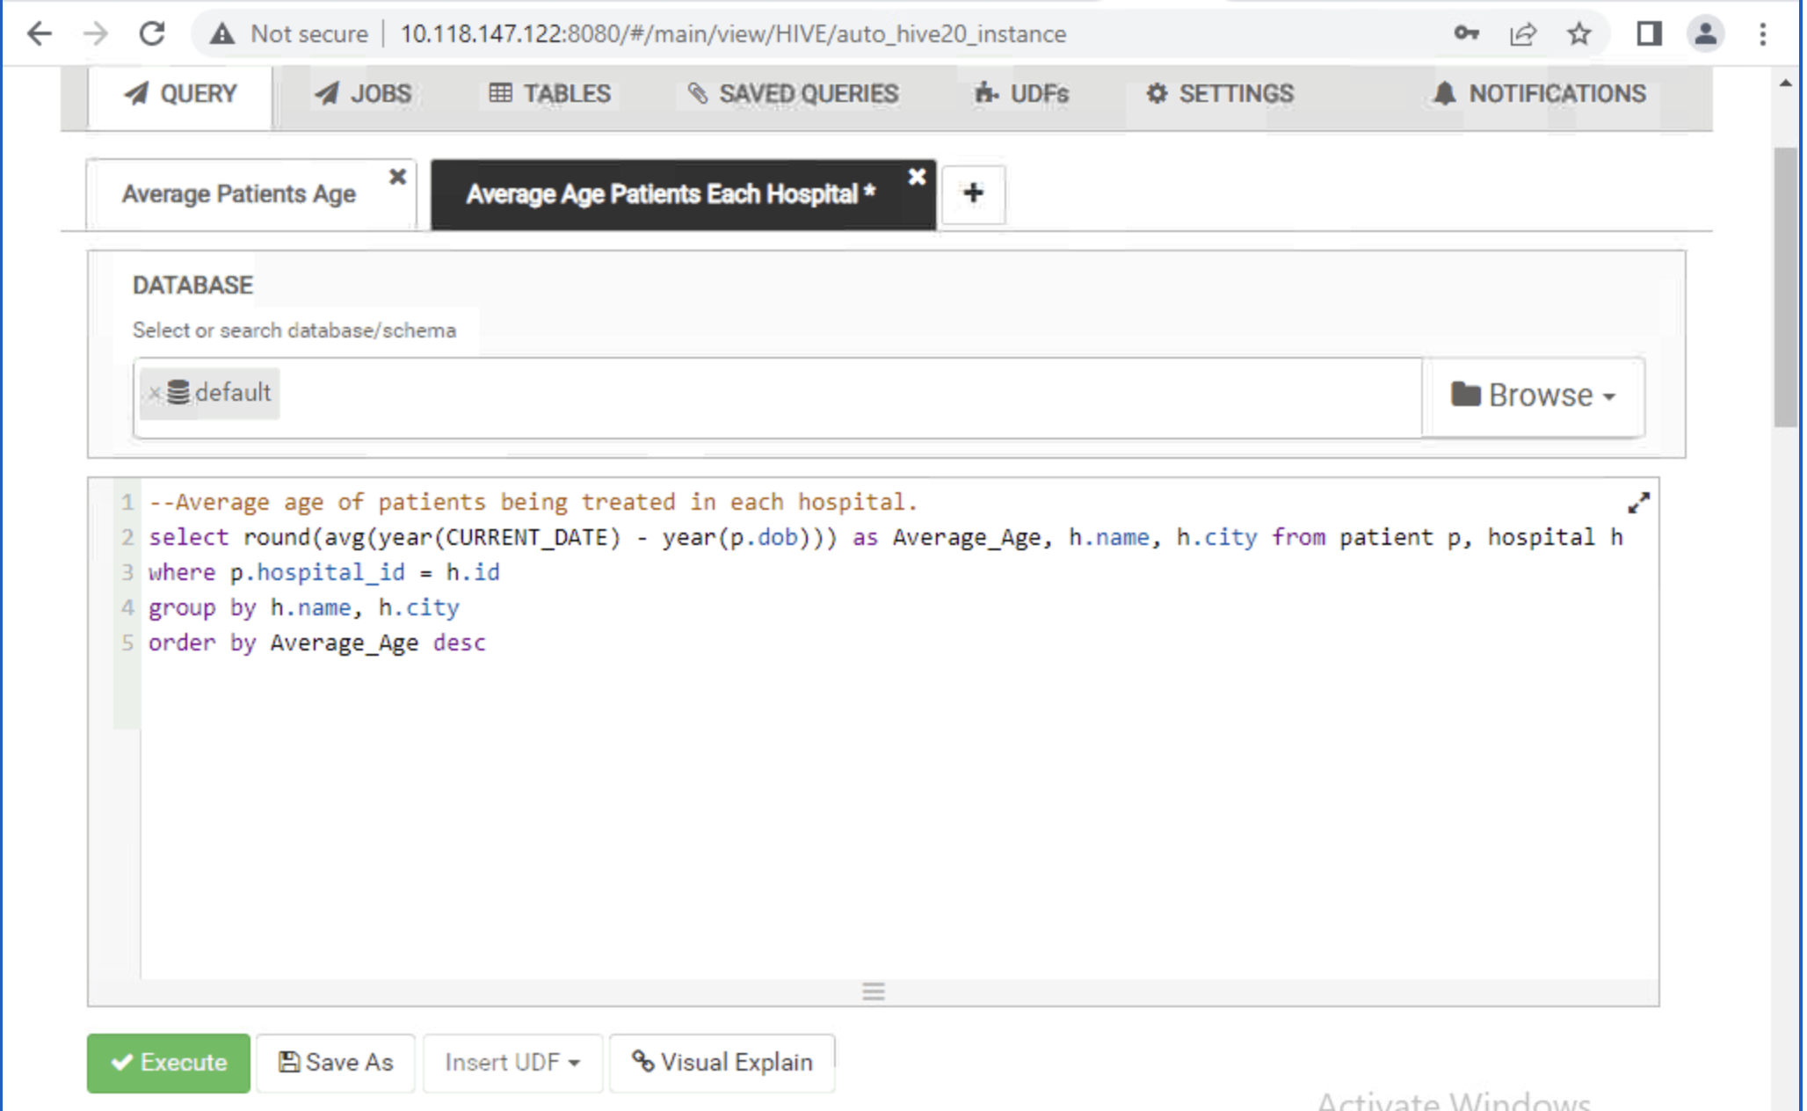
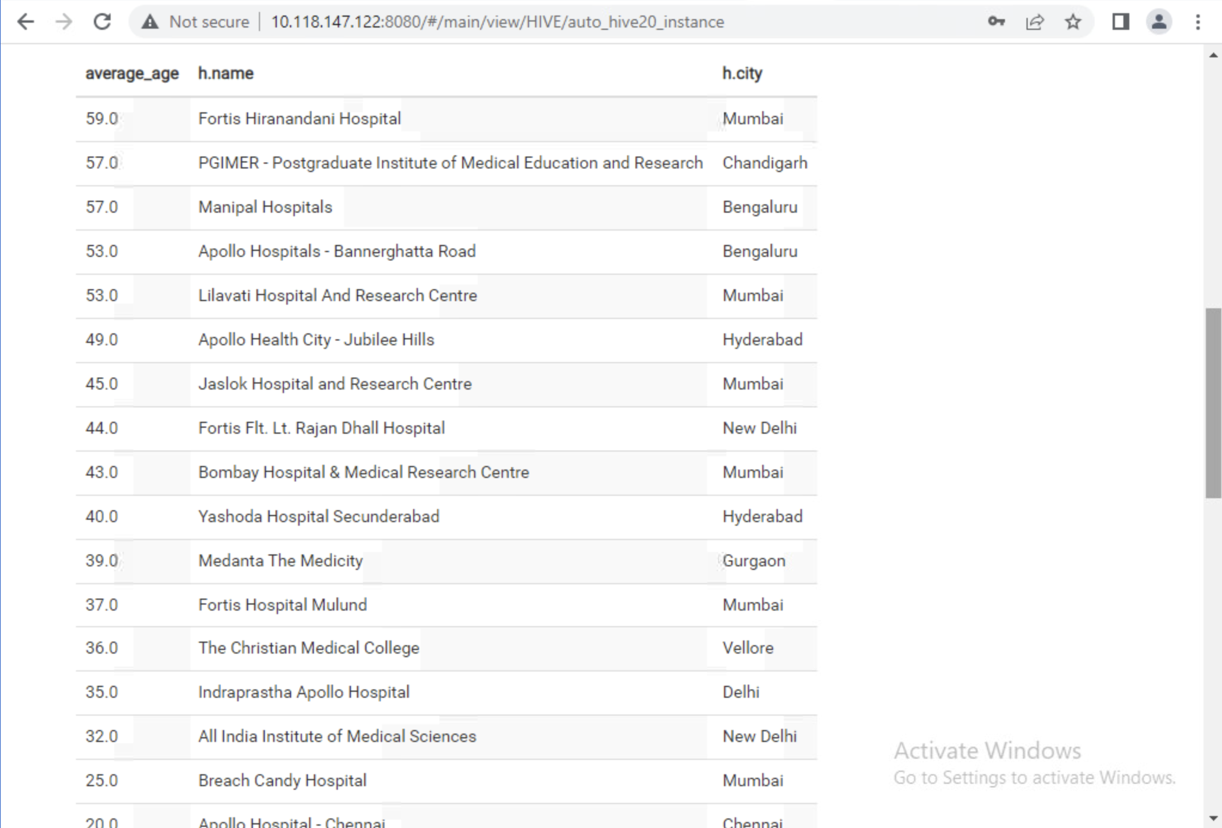
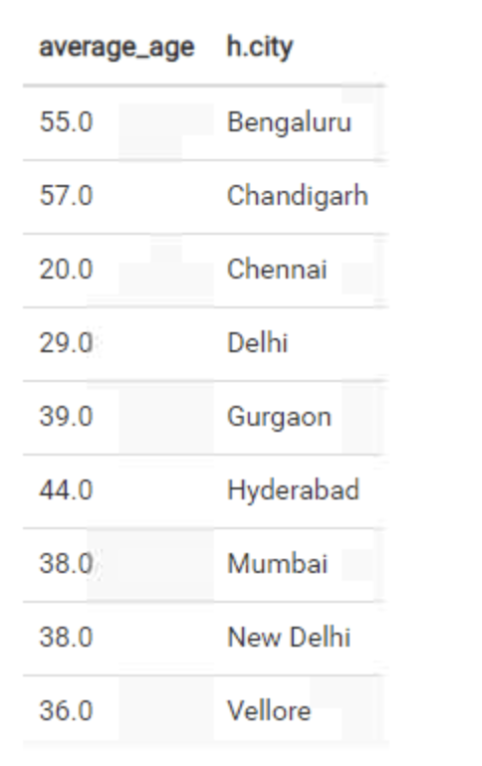
Average age of patients affected
with diseases.

Slide 10
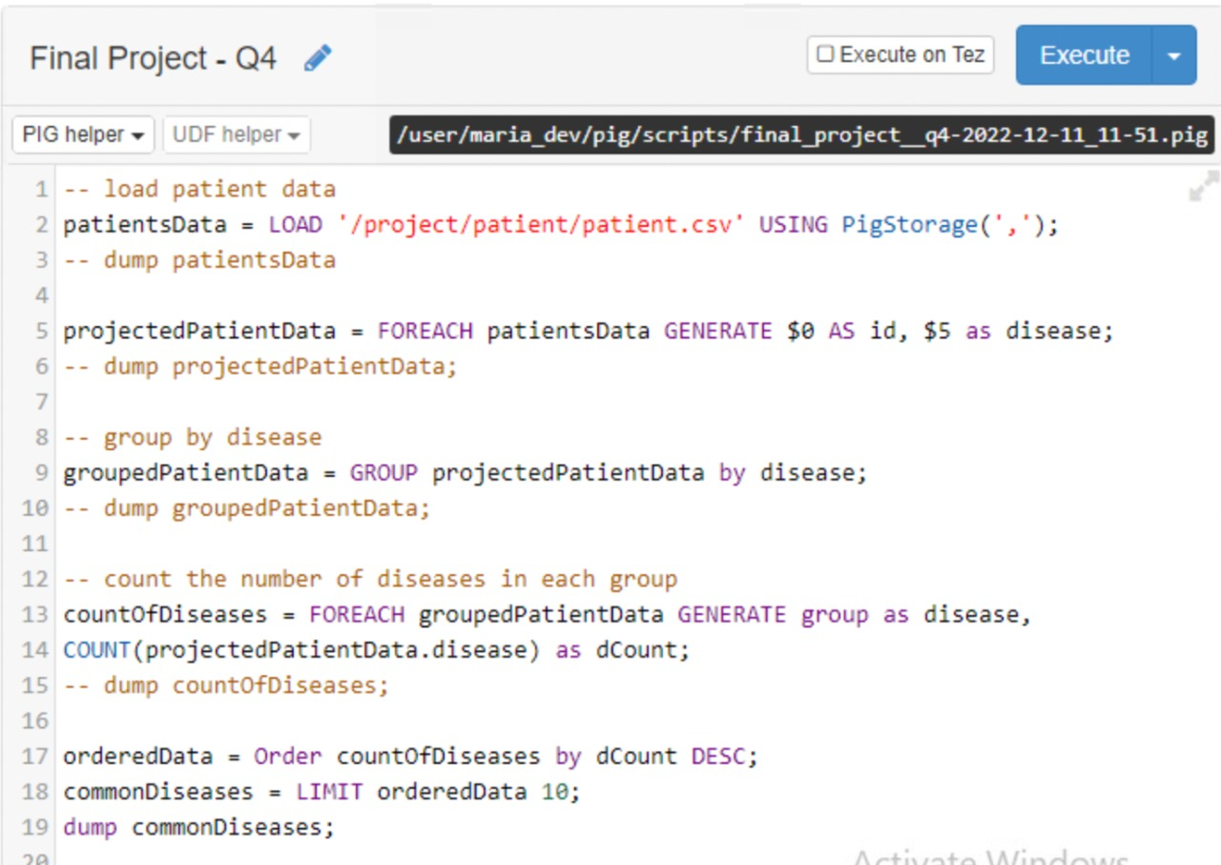
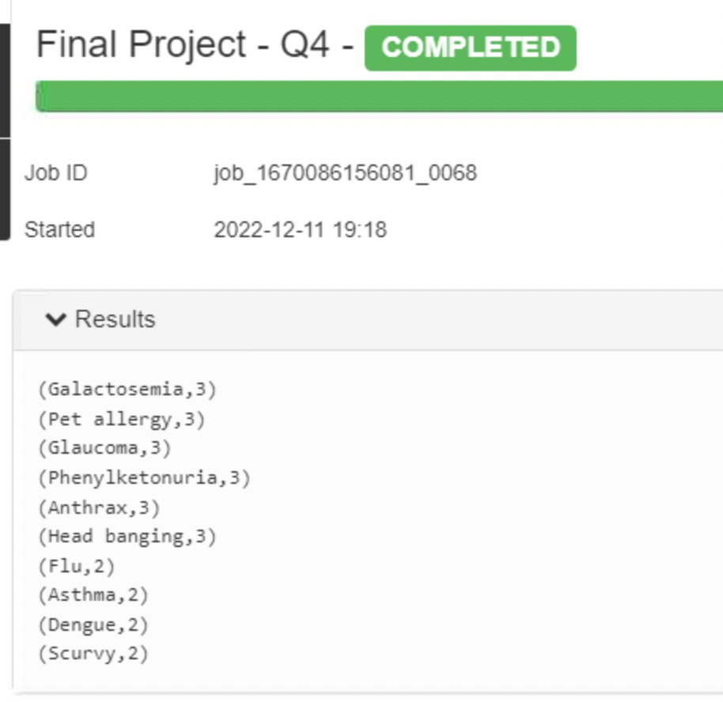
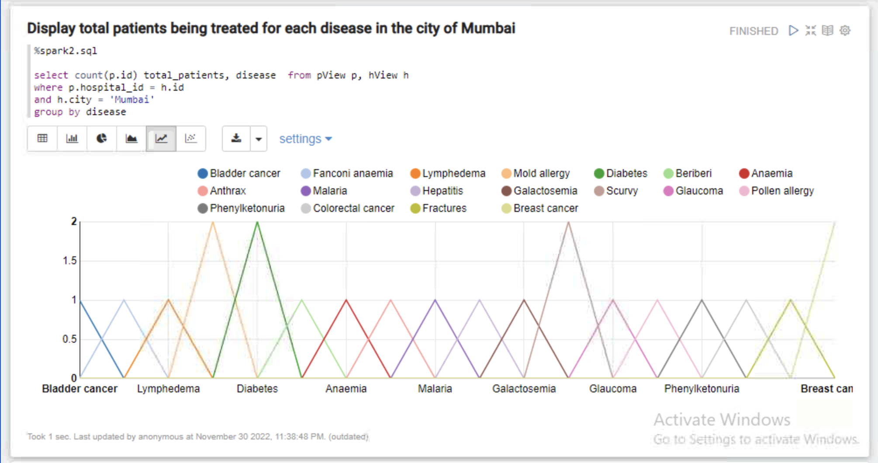
Common
diseases which affecting most

Slide 11

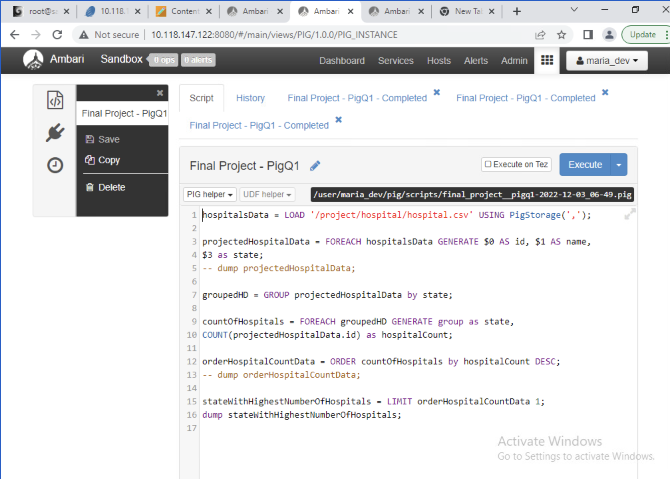
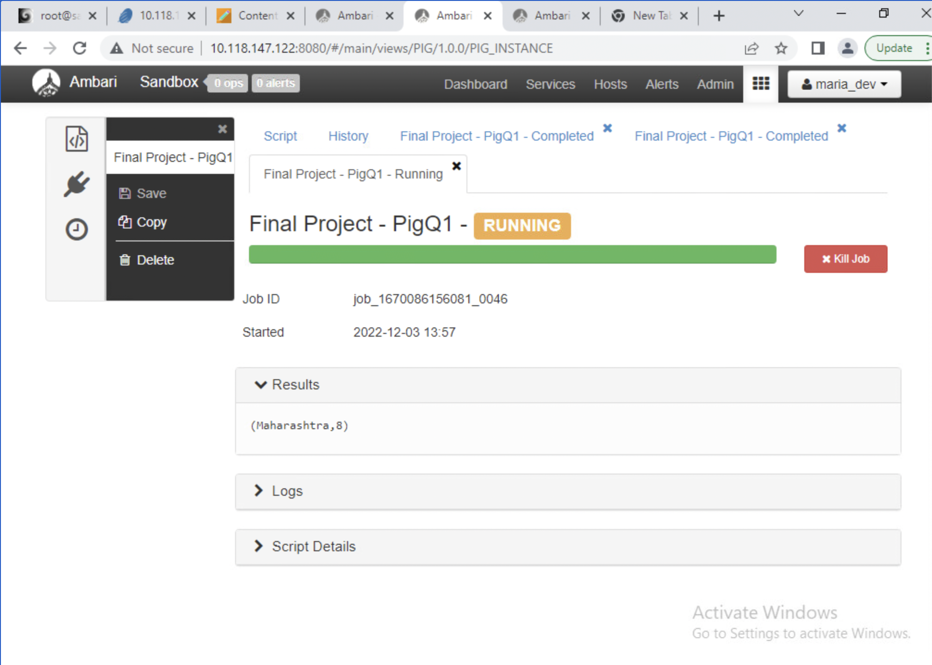
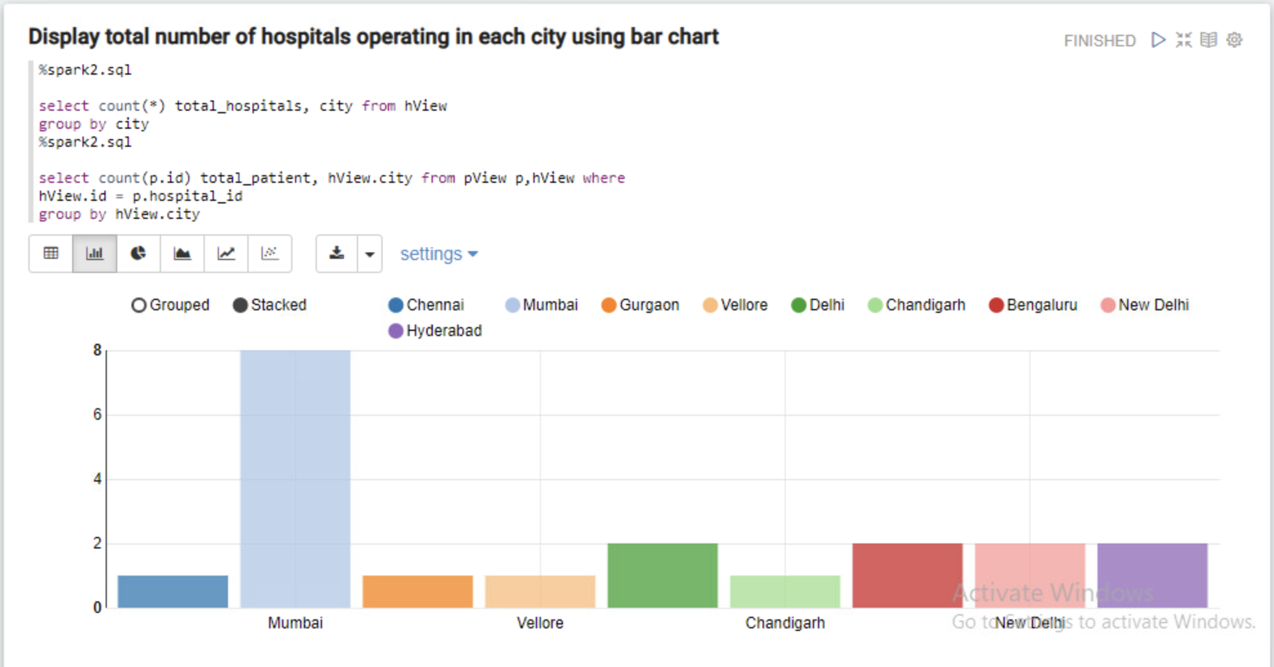
Number of
hospitals in
different cities.

Slide 12
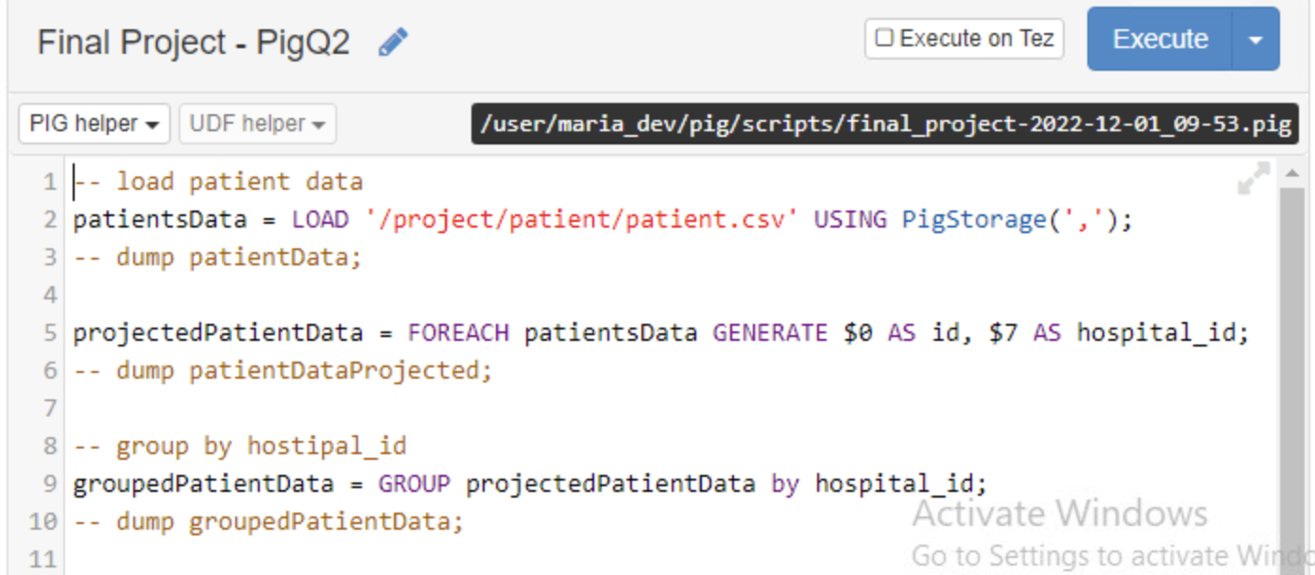
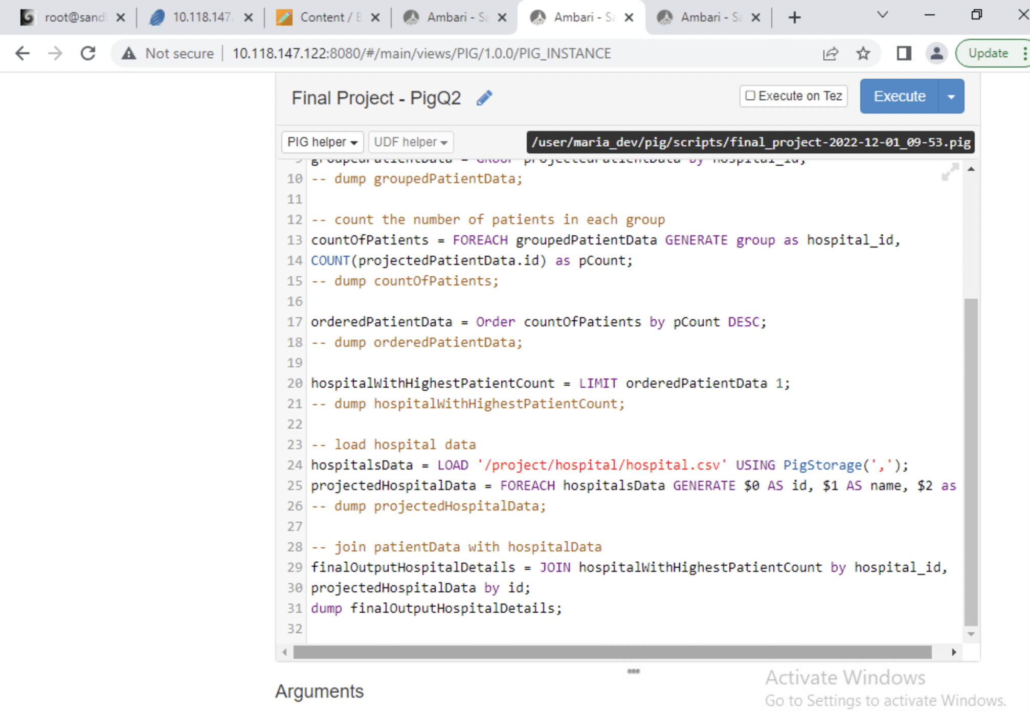
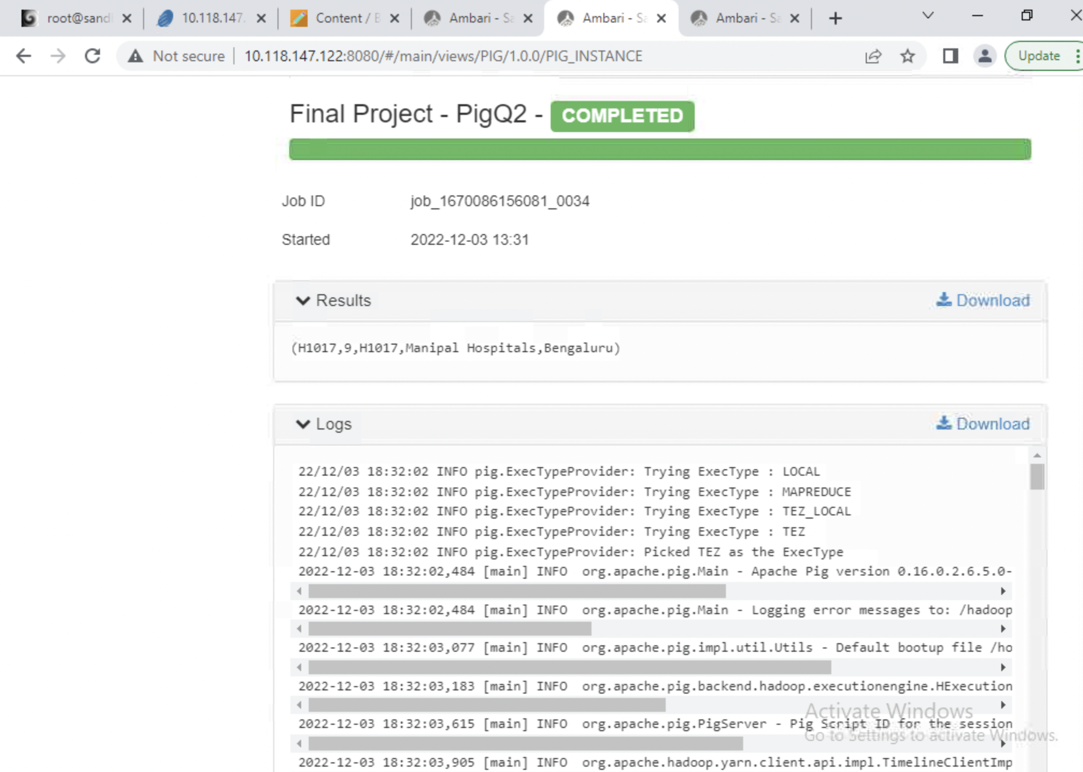
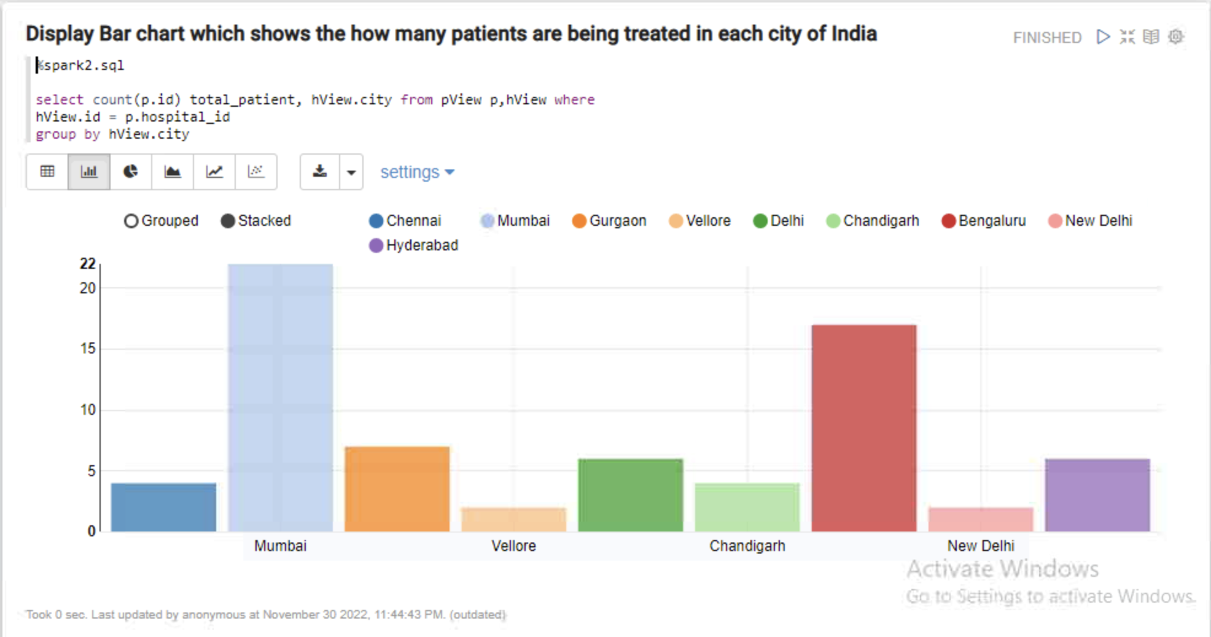
Which
Hospital and city
recorded the
highest number
of patients.

Slide 13
Analyzed Output
Avg age of Patients | Gender Ratio | Affected Diseases | Occupied hospitals | Most affected city
35 - 55 | 6:4 (M:F) | Galactosemia Pet Allergy Glaucoma | H1017 Manipal Hospitals | Mumbai Bengaluru
The 3 diseases are affecting most of the Male gender between the age group of 35-55 in Mumbai and Bengaluru cities. The state Maharashtra is having maximum number of hospitals to provide services to these cities.

